Slide 1


Housing_Price_Prediction
By – Santosh Reddy

Slide 2
Problem statement
A US-based housing company named Surprise Housing has decided to enter the Australian market. The company uses data analytic to purchase houses at a price below their actual values and flip them at a higher price. For the same purpose, the company has collected a data set from the sale of houses in Australia. The data is provided in the CSV file below. The company is looking at prospective properties to buy houses to enter the market. You are required to build a model using Machine Learning in order to predict the actual value of the prospective properties and decide whether to invest
in them or not. For this company wants to know:
Which variables are important to predict the price of variable?
How do these variables describe the price of the house?

Slide 3
You are required to model the price of houses with the available independent variables. This model will then be used by the management to understand how exactly the prices vary with the variables. They can accordingly manipulate the strategy of the firm and concentrate on areas that will yield high returns. Further, the model will be a good way for the management to understand the pricing dynamics of a new market.
Data contains 1460 entries each having 81 variables.
Data contains Null values. You need to treat them using the domain knowledge and your own understanding.
Extensive EDA has to be performed to gain relationships of important variable and price.
Data contains numerical as well as categorical variable. You need to handle them accordingly.
You have to build Machine Learning models, apply regularization and determine the optimal values of Hyper
Parameters.
You need to find important features which affect the price positively or negatively.
Two data sets are being provided to you (test.csv, train.csv). You will train on train.csv data set and predict on
test.csv file.
The “Data file.csv” and “Data description.txt” are enclosed with this file.

Slide 4
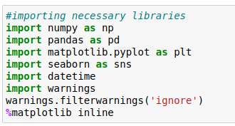
Importing the necessary libraries
We are going to import necessary libraries to use in the project
We imported some of the libraries that are mainly useful for analyze the data set,there are other libraries which will be imported in the flow of project, some are useful for statistical analysis and some are useful for visualization

Slide 5
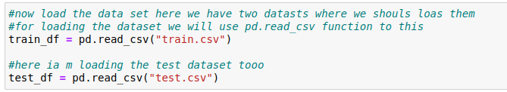
Importing the data set
Now we have to import the data set in pandas we have read_csv function in the pandas to load the data set, here we have two data sets train and test
We need to edit both the files as there will be null values in the dataset
We have imported the the data set lets check the shape of the data set and it has any null values

Slide 6
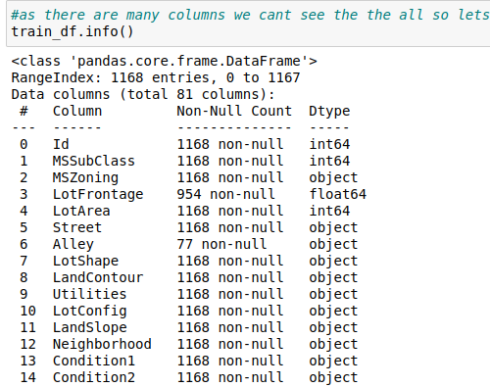
Exploratory Data Analysis
This is the step where we are going to analyze and represent dataset in visual way and we have to see if there is any pattern in the data so we have to use them for feature engineering
Lets stat with shape and
information of data-set in
pandas we have .shape
and .info() methods which
shows us information and
shape of the data

Slide 7
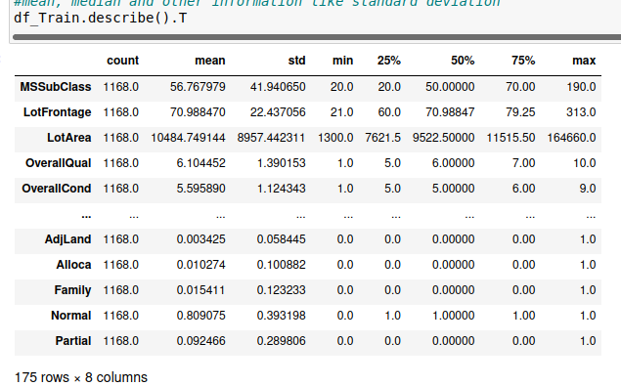
Describe function in pandas helps in the to get details about the statistical data like mean, median, std and percentiles of the data

Slide 8


In this problem statement the data sets that are given have some differences in train and test data sets and e need to replace them
Here I will concatenate the both data sets into final data set and we need to remove the null values and make changes to the categorical variables
After removing null values and encoding the categorical variable we will divide the data set into train and test data sets

Slide 9
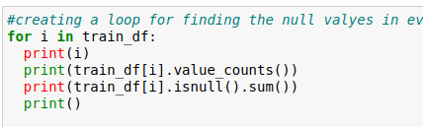
We have to check the null values in the data set, in
pandas we have .isnull() method to see the null values
in this data set we don't have any null values
Lets proceed further
When come to the visualization we have some
visualization libraries we have used in this project are
Matplotlib
Seaborn
Sweet viz
yellow brick

Slide 10
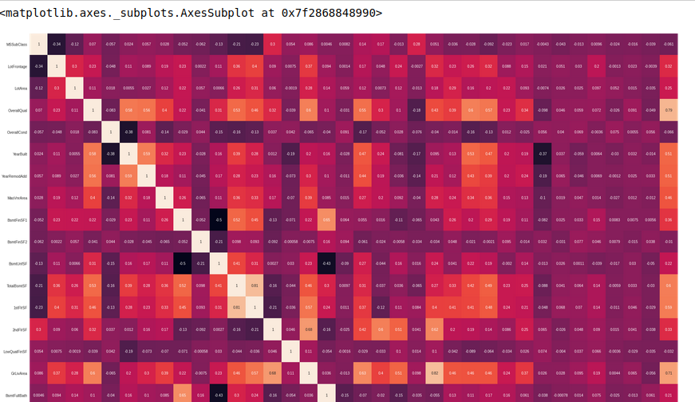
For visualization I have used matplotlib, seaborn, yellow brick , visualization is most important part of machine learning project as it tells us about the
Mainly if want to check the multicolinerarity or correlation and relation with the target variable we will be using visualizations I will display some of them
This is heatmap we will be
using for checking null vals
and correlation between
variables and target variables

Slide 11
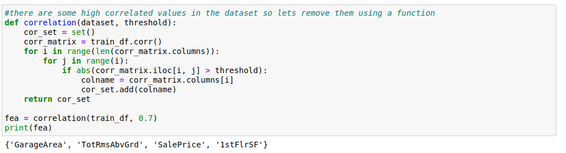
I have used heat map for correlation representation . Since there are more columns we cant tell which is highly correlated so, I am going to create a function that gives us the results so we can drop those columns
We are done with the correlation lets continue with outliers

Slide 12
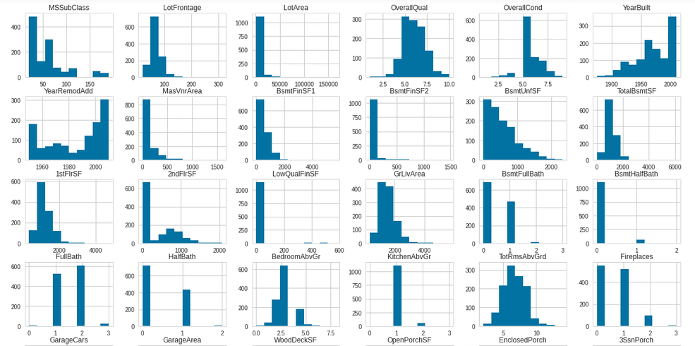
Here we are seeing hist plots which shows us the data distribution and also the the way the data is distributed and it is most in model building, If data is distributes normally then there is no problem otherwise we have to make it normalize with methods liks log normal distribution

Slide 13
Correlation:
Correlation is defined as relation between two variables on how data is influenced by the change of another variable so lets check that
We will use it to know the relation between the other variables to target variable

Slide 14
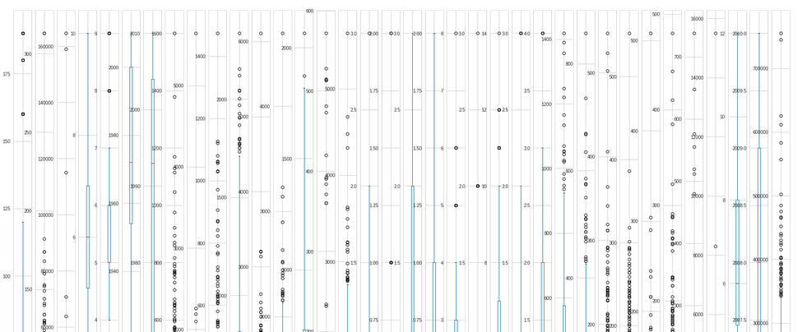
Outliers:
Outliers are the most important important thing to handle in machine learning project cycle , it has huge impact on model creation and prediction

Slide 15
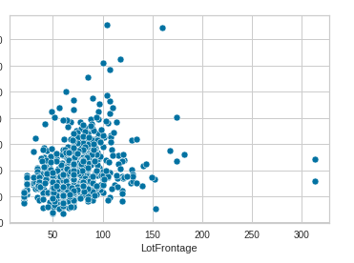
I have a function to represent the outliers using box plot and hist plot if we have outliers we are going to handle using IQR (inter quartile range) and
Here we have scatter plot an other oprion for outlier detection
and we can use same methods for removing
outliers in the dataset

Slide 16


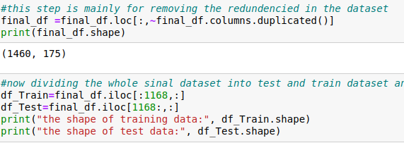
Actually there is aproblem in the test dataset in this problem that is categorical data in test dataset differs from the train dataset so we have to merge those data sets and apply methods that are necessary and then divide them
After combining the data first I handled the null values and later the one hot encoder to encode the categorical data and hen we divided the dataset into test and train datasets
Here we applies a function for
reducing the redundencies

Slide 17

Dividing dependent and independent variable
Now we are dividing the dependent and independent variables
Now lets start with feature scaling method
Scaling is needed for scale the data for model creation because all the machine learning models will accept only normalized data the scaling methods we will use is StandarsScalar, Robust scalar and power_transform

Slide 18
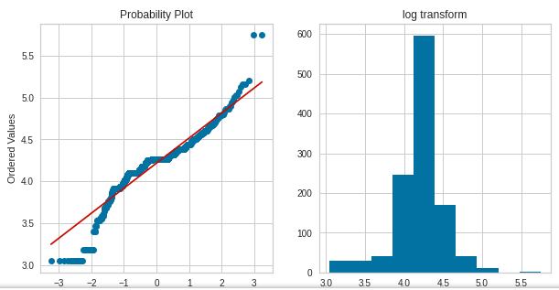
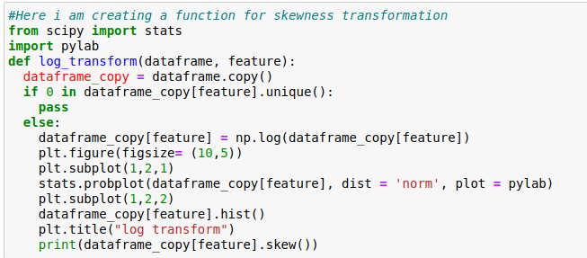
Here we are using the probabplot for checking the skewness of the data and we need to apply appropriate method for appropriate method for removing the skewness
There are many methods to handle the skewness
like log transformation and others

Slide 19
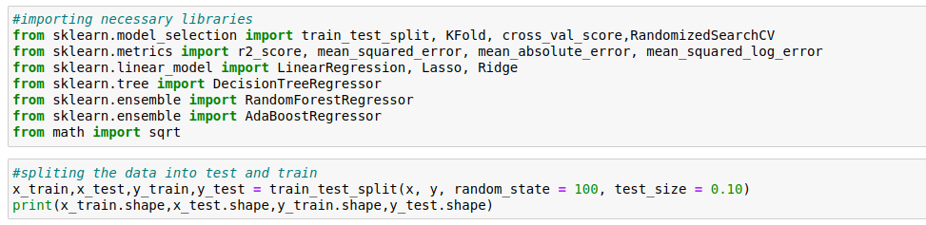
Model creation
Her I am using linear regression as we have to predict the prices along with the regularization like Lasso and Ridge regressor
At first we need to import all the metrics and other things to get startes

Slide 20
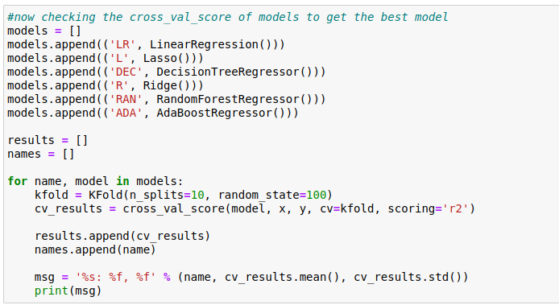
Checking the Cross Val Score
Before creating the model we have to check the cross val score to make sure that
Cross-validation is a technique in which we train our model using the subset of the data-set and then evaluate using the complementary subset of the data-set.

Slide 21
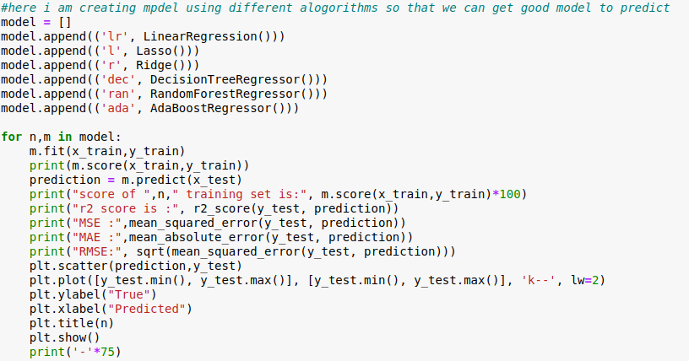
Model Creation
In this step we start using a set of a set of algorithms we need to create the model and them we need to predict the test data

Slide 22
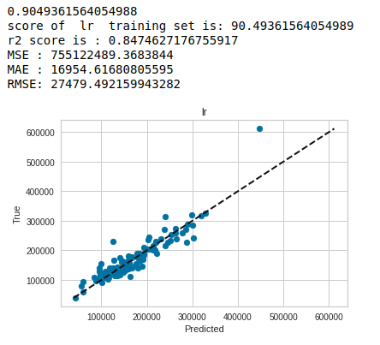
Accuracy
After creation of model we have to hve to check the accuracy of the model
We have to make a note of
R2 score, MSE, MAE, RMSE
these are important metrics
that defines the models
acuracy

Slide 23
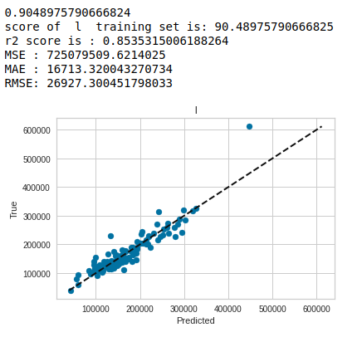
We are using many regressors for prediction of the data using these following metrics

Slide 24
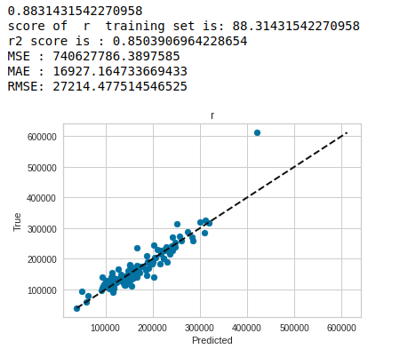

Slide 25
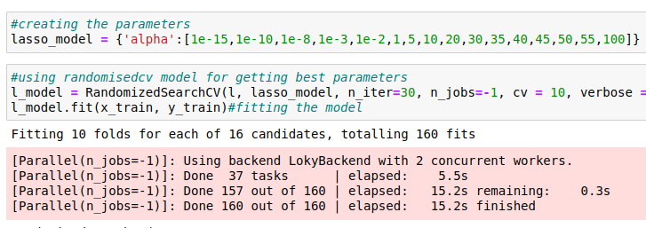
There is a littledifference between cross val-score and normal prediction score so i am gonna pick one best model for performing hyper parameter tuning and saving the model, here I am picking random forest model and started with hypert parameter tuning here I am using hyper parameter tuning for all the models
In hyper parameter tuning we will tune the best model with change of paramters so that we will achieve good results

Slide 26
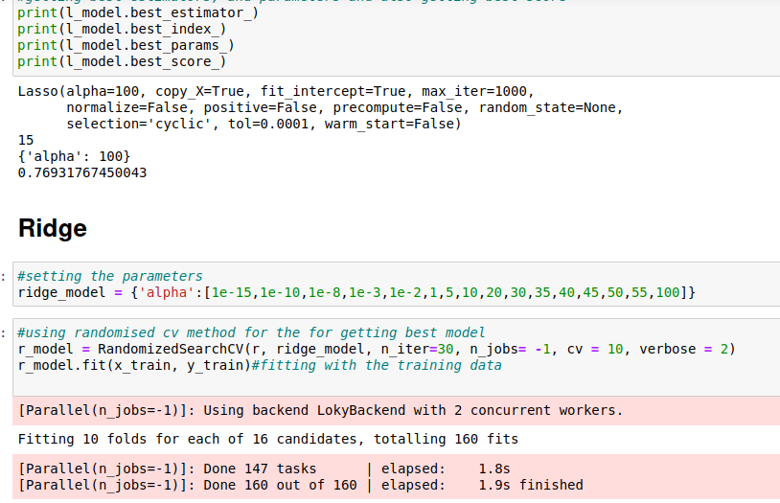

Slide 27
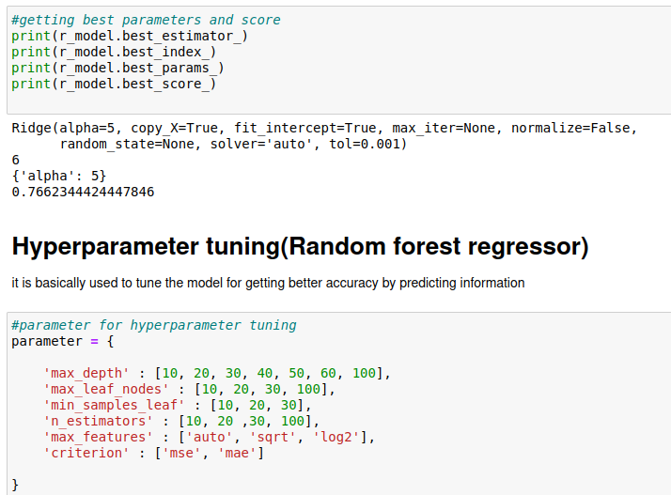

Slide 28
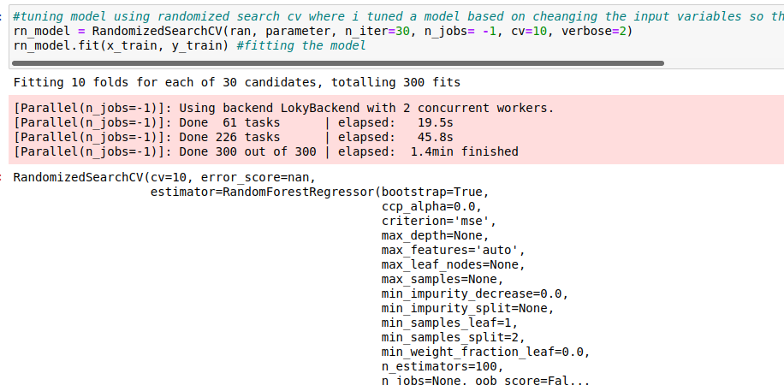

Slide 29
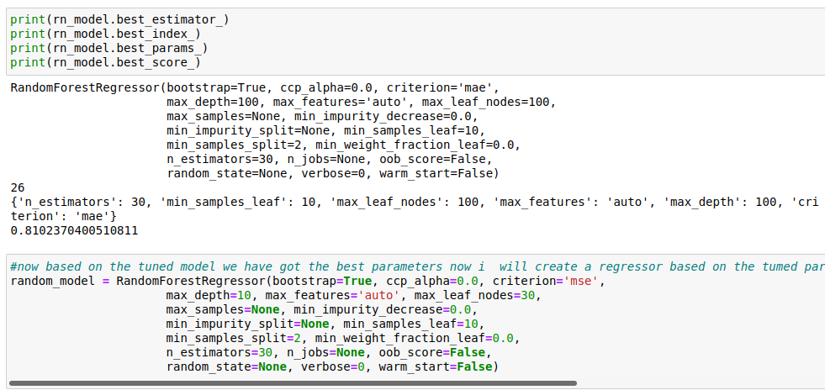

Slide 30
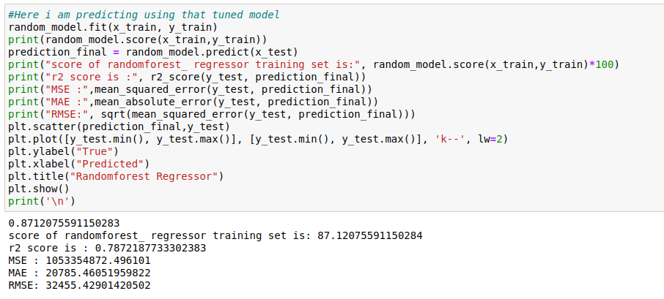
Now fitting the tuned model(Random forest model)

Slide 31
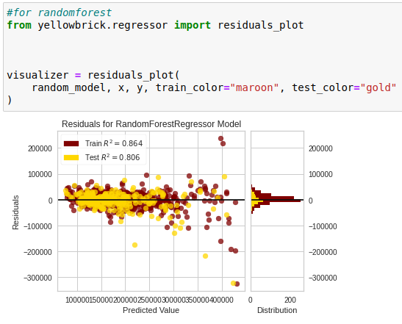
Residual plots
Residuals, in the context of regression models, are the difference between the observed value of the target variable (y) and the predicted value (ŷ), i.e. the error of the prediction. The residuals plot shows the difference between residuals on the vertical axis and the dependent variable on the horizontal axis, allowing you to detect regions within the target that may be susceptible to more or less error.

Slide 32
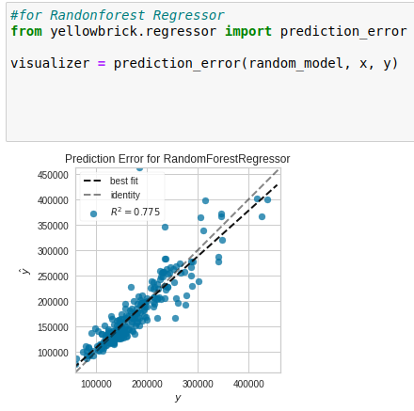
Prediction error plot
A prediction_error helps find where the regression is making the most errors. More about Prediction Error Plot, it also shows you the best fit of the linear regression

Slide 33
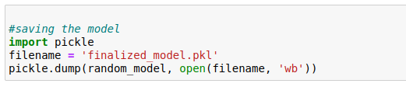
Saving the model
We are going to save the model using a library called joblib with the extension of
.obj or pkl

Slide 34
Conclusion
So after all those steps in the in creating model we have finally achieved an accuracy of 84 percent, and we have saved model for further use, we have tested the model on some metrics like AU C-ROC etc, didn't use pair plot as there are more columns it will take more time
You can find the notebook link here

